Slide 1
A Low-Cost Vision-based System to Improve Efficiency of Assembly Lines in Ready-made Garments Factories
Project Funded by University Grants Commission

Slide 2
Agenda
Objective
Methodology
Project Demonstration
Used Technology
Deployment Plan
2

Slide 3
Context
Existing Scenario
Garment manufacturing relies heavily on human workers.
Large factories may have hundreds of workers operating simultaneously.
Currently, worker activity is often monitored manually by supervisors.
Manual monitoring is difficult to scale and provides limited quantitative and continuous records.
3

Slide 4
Project Objective
Garments Activity Recognition System
Detect and track multiple workers using existing CCTV footage.
Monitor their movement during sewing-related activities.
Identify active/work-related vs. inactive/non-work-related states.
Generate quantitative activity records for individual workers.
Operate without requiring additional wearable sensors or dedicated cameras.
4

Slide 5
Methodology
Garments Activity Recognition System
Identity Hand Positions
Tracking Hands over the frame
Feature Extraction
Activity Classification
5

Slide 6
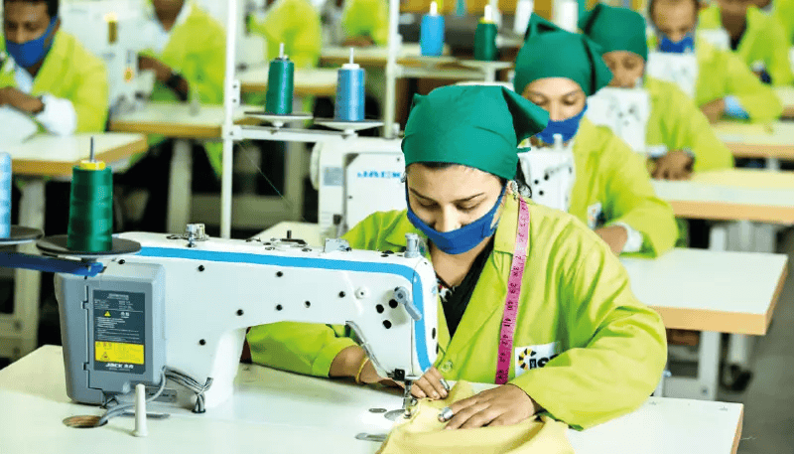
Methodology
Identify the workers and their hands positions
Fig 01: Sewing Workers in a Garment Floor
6

Slide 7
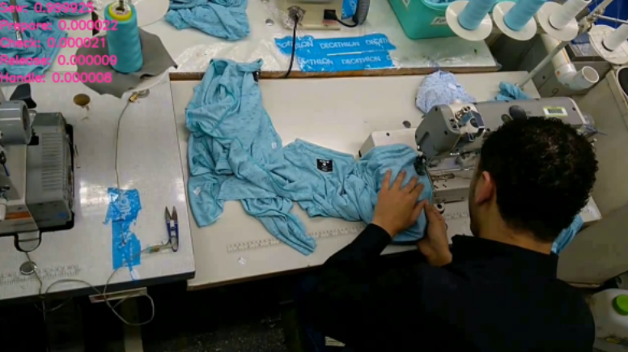
Methodology
Existing Dataset: VerSew [1]
About Dataset:
3,121 high-resolution videos containing approximately 49,936 frames.
Captures the actions of 34 sewing machine operators and maintenance workers.
About Dataset:
Contains one person per frame
Fig 02: Frame from VerSew Dataset
7

Slide 8
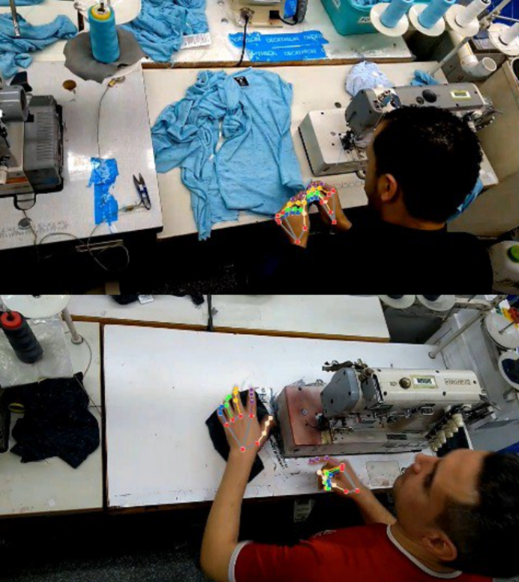
Methodology
01. Identify Hand Positions
Key Point Based Models
Movenet (Thunder Variant)
17 human body key points
MediaPipe Holistic (Mediapipe)
Holistic extracts 540 landmarks, including 33 pose landmarks, 21 landmarks per hand, and 468 facial landmarks
Fig 03: Detecting Hands Using Key points Based Model
8

Slide 9
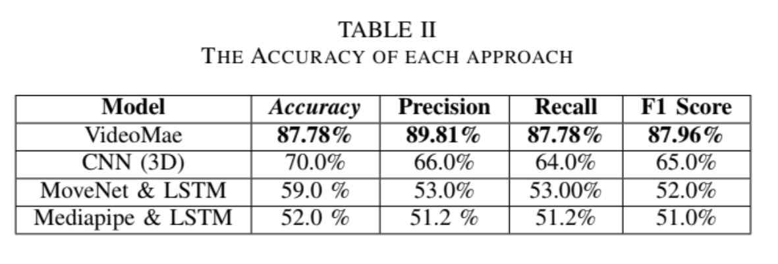
Methodology
Existing Work: Enhanced Garments Sewing Activity Recognition [2]
Findings:
Poor quality of key points extractions.
Blurry and noisy hand movements and varying angles.
Fig 04: Results of paper [2]
9

Slide 10
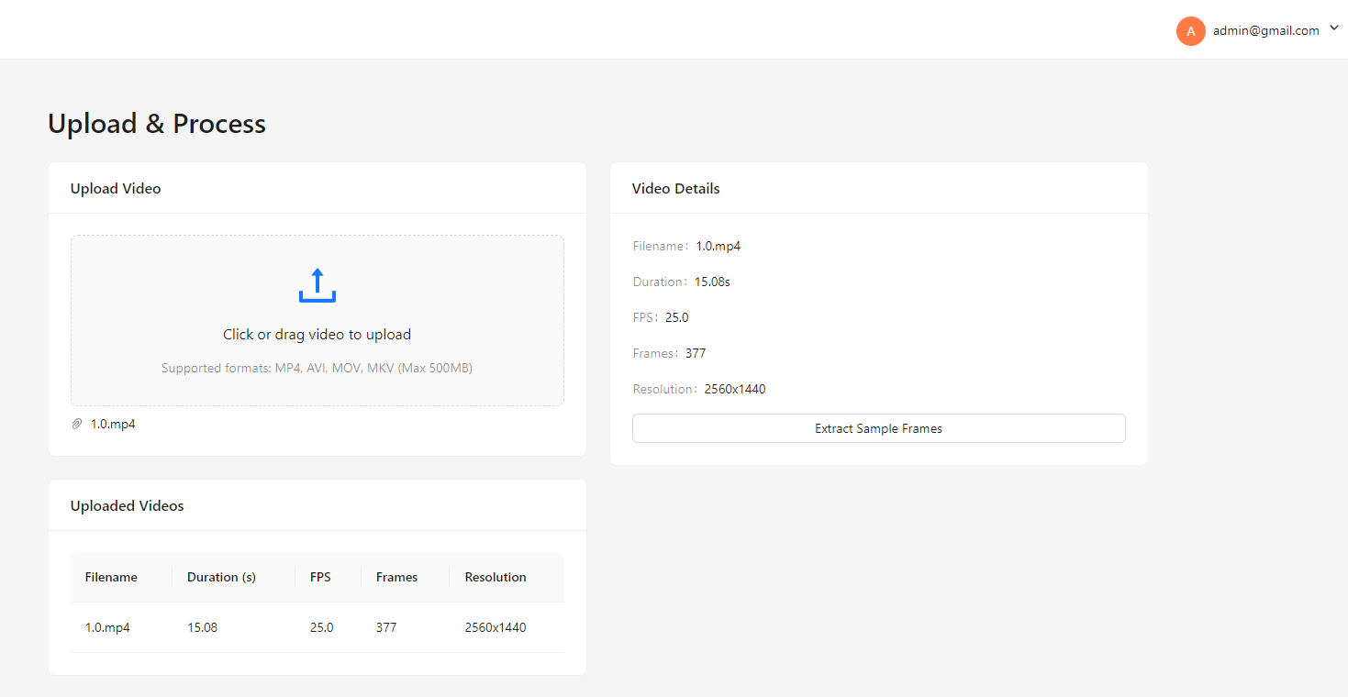
Methodology
Proposed Solution: Use color based segmentation for hand detection
Preprocessing:
Evenly Distributed Frames
Convert to HSV
Illumination Invariant (CLAHE + Gamma Correction)
ROI selection (Otsu)
HSV color range
Fig 05: Video Upload and Extract Frames
10

Slide 11
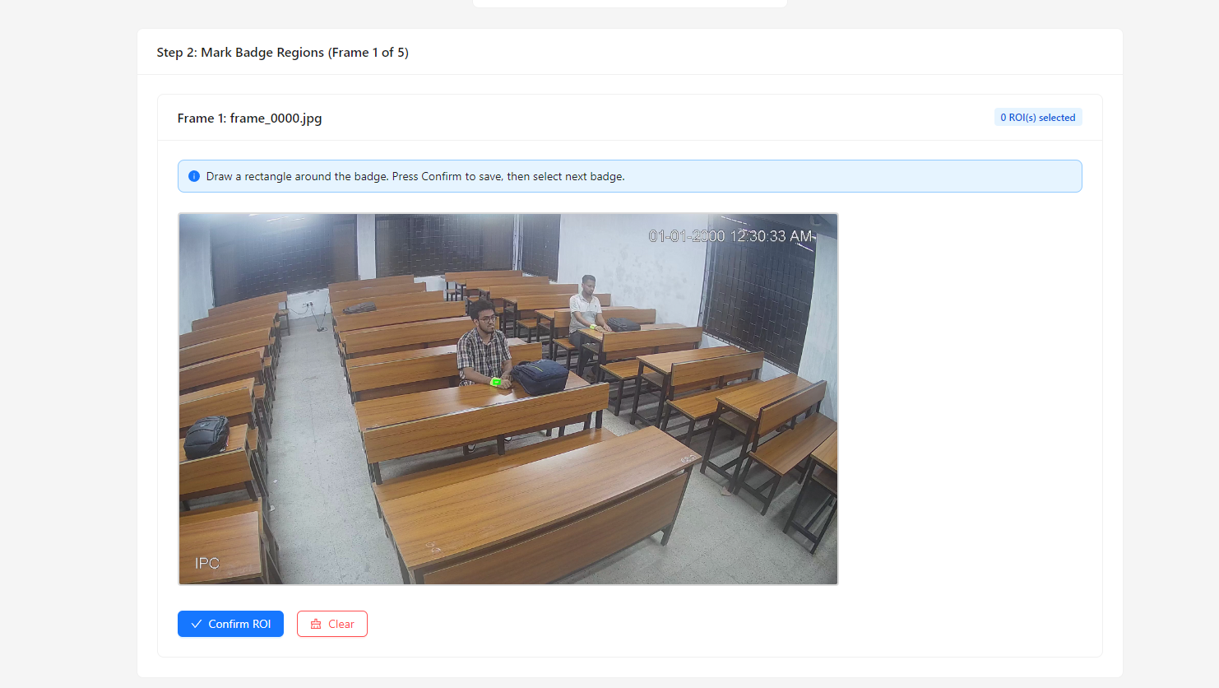
Methodology
Proposed Solution: Use color based segmentation for hand detection
Detection:
Use HSV Color range
Morphological Opening and Closing
Contour Generation
Remove Noise
Fig 06: ROI selection
11

Slide 12
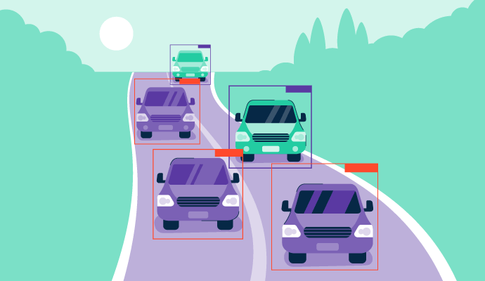
Methodology
02. Tracking Hands
Popular Algorithms [3]
Kalman Filter
Hungarian Algorithm
Proposed Solution
Distance Based identity tracking.
Fig 07: https://g2.com/object-detection
12

Slide 13
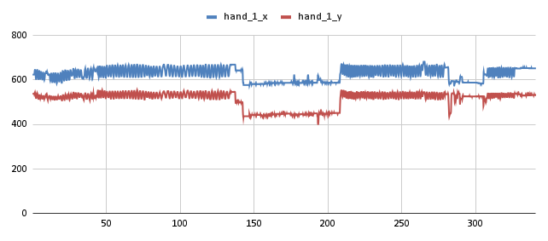
Methodology
03. Extract Meaningful Features
Amplitude
Dominant frequency
SD of hand coordinates
Mean Speed
Motion Variability
Total Displacement
Fig 08: Hand Movement
13

Slide 14
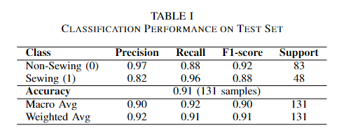
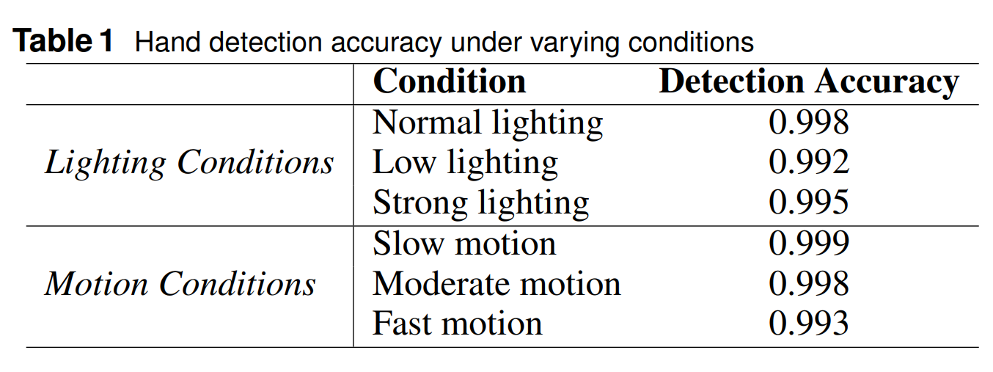
Methodology
03. Classify Working States
Fig 09: Model Result
14

Slide 15
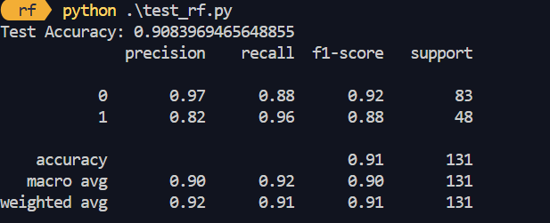
Methodology
Classification Model
KNN
Average validation accuracy 0.79
Average test accuracy 0.74
Random Forest
Non Sewing F1 Score 0.92
Sewing F1 Score 0.88
Fig 10: Model ResultRandom Forest
15

Slide 16
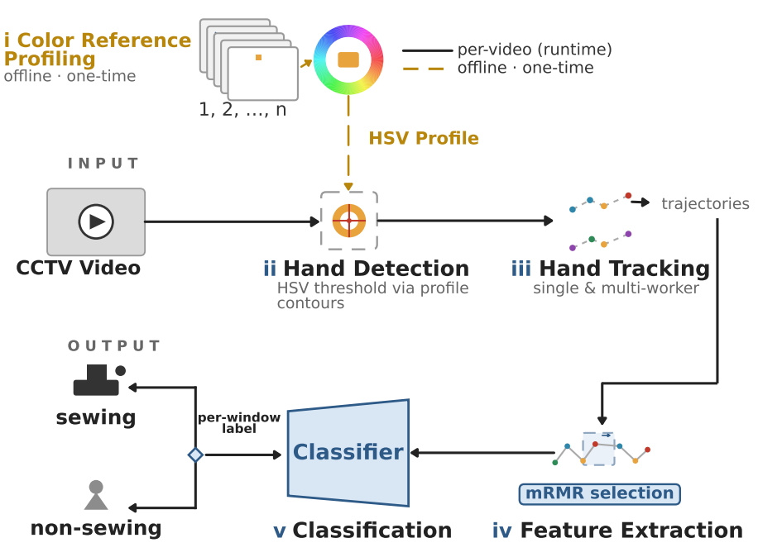
Workflow Diagram
Fig 11: Workflow of GARS
16

Slide 17
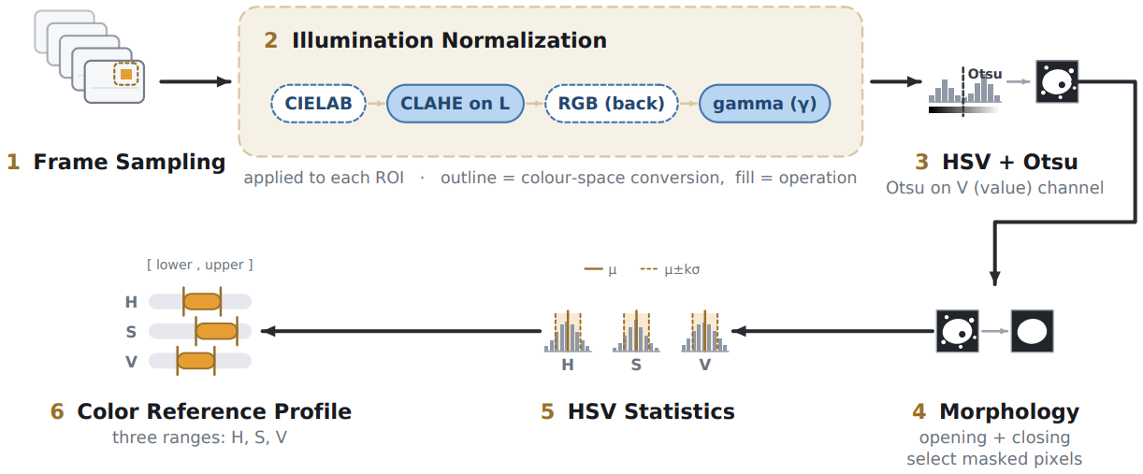
Workflow Calibration Process
Fig 11: Workflow of Calibration Process
17

Slide 18
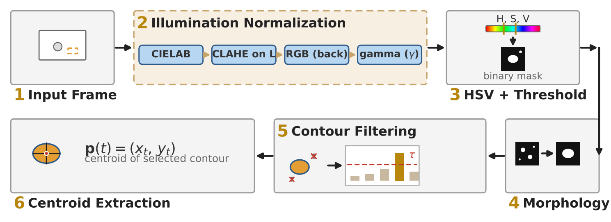
Workflow Detection Process
Fig 11: Workflow of Detection Process
18

Slide 19
Output Demo
Output Video Link
19

Slide 20

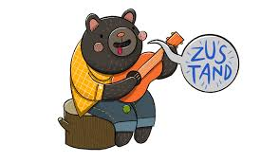


Used Technology
Frontend:
NestJs
Zustand (state management)
Axios Data fetching
Backend:
FastAPI (python)
OpenCV, Scikit-learn, Numpy, Pandas
20

Slide 21



Used Technology
Database:
MongoDB
ML Model:
Random Forest
Testing:
Pytest
Deployment:
Docker
Version Control:
Git, Github
21

Slide 22
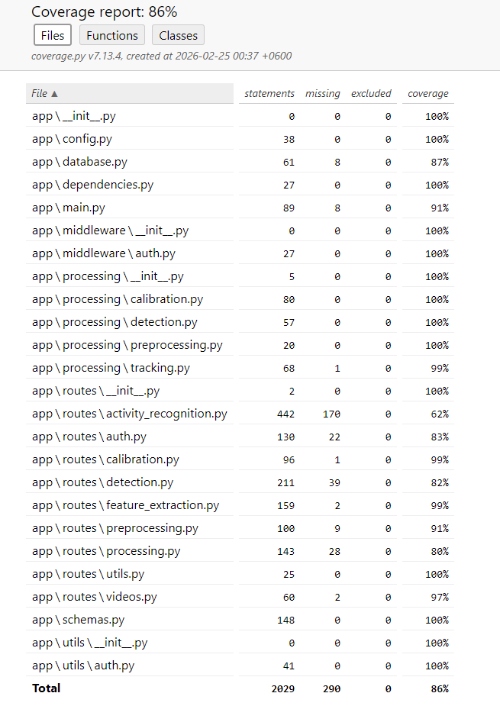
Testing
Test Suite Composition:
Unit test cases: 460
Integration test cases: 10
Total test cases: 470
Test Execution Results:
Total test cases executed: 470
Test cases passed: 470
Test cases failed: 0
86% statement coverage
Fig 12: Unit test coverage
22

Slide 23
Module | Test Count | Test File | Coverage | Status
Routes (HTTP Endpoints) | 207 | test_activity_recognition.py, test_auth.py, test_calibration.py, test_detection.py, test_feature_extraction.py, test_preprocessing.py, test_processing.py, test_utils.py, test_videos.py | 80-99% | All passing
Processing Algorithms | 127 | test_calibration.py, test_detection.py, test_preprocessing.py, test_tracking.py | 99-100% | All passing
Utilities | 34 | test_auth.py | 100% | All passing
Middleware | 28 | test_auth.py | 100% | All passing
Foundation (Database, Schemas, Dependencies) | 64 | test_database.py, test_schemas.py, test_dependencies.py, test_main.py | 87-100% | All passing
Integration | 10 | test_routes_integration.py | N/A | All passing
TOTAL | 470 | 14 test modules | 86% | All 470 passing
23

Slide 24
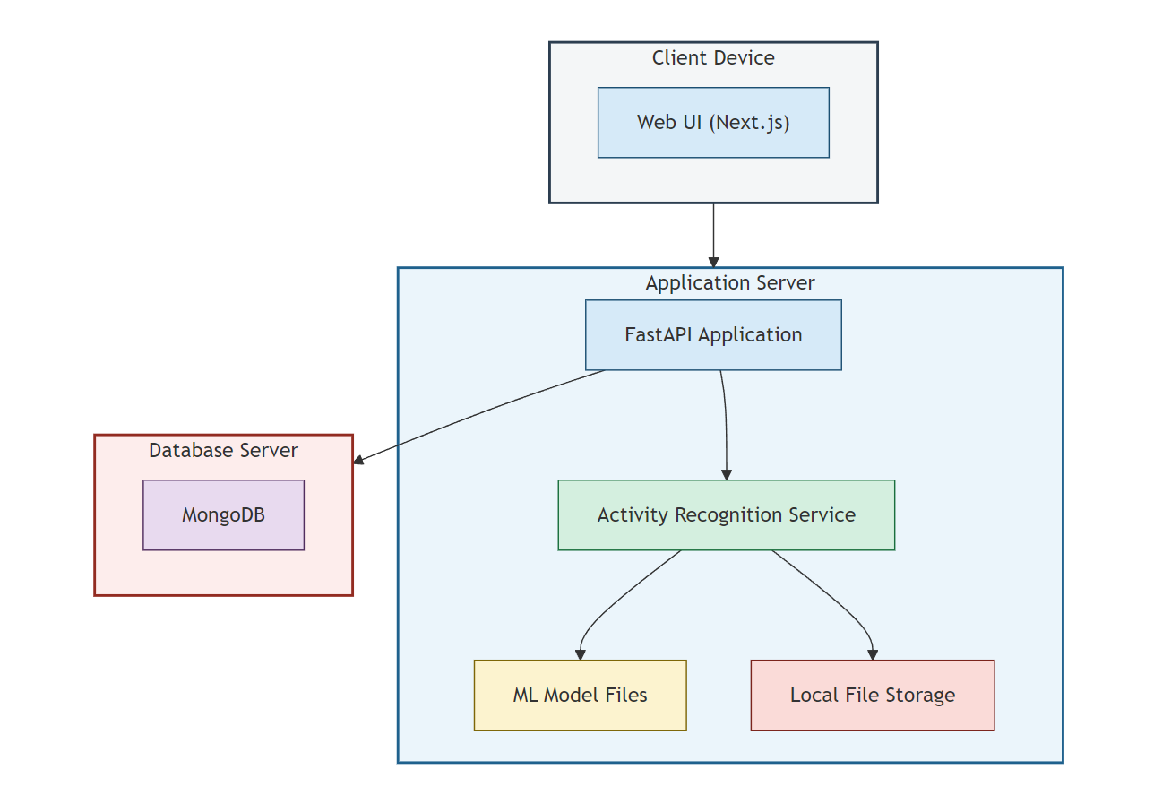
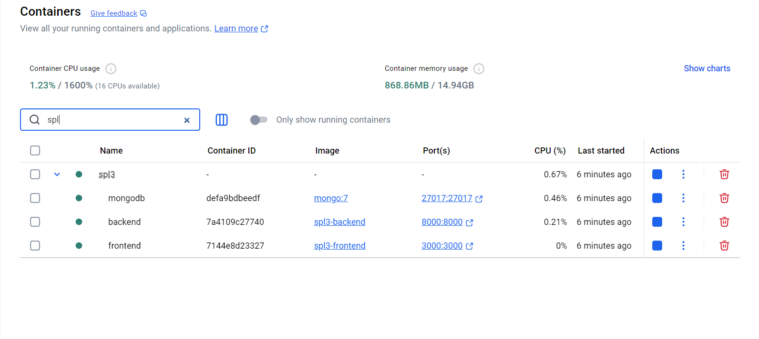
Deployment
Fig 13: Docker Containers
24

Slide 25
Appendix
Aly Fathy, VARSew: A Literature Review and Benchmark Dataset for Visual Recognition in Garment Sewing, IEEE Intelligent Methods, Systems, and Applications (IMSA), 2023
Mustafa Marzuk, Enhancing Garment Sewing Employee Added Value Monitoring Using a Video-Based Spatio-Temporal Approach Through Computer Vision, IEEE Intelligent Methods, Systems, and Applications (IMSA), 2024
Zhibo Zou, Compensation Tracker: Reprocessing Lost Object for Multi Object Tracking, IEEE/CVF WACV, 2022
Wenhang Su, Chengjun Wang, Jiabao Li, Zhipeng Yu, Li Jin, A novel feature extraction framework based on periodic features for human activity recognition using wearable sensor data, Digital Signal Processing, Volume 168, Part C, 2026, 105584, ISSN 1051-2004
Jun Liu, Skeleton-Based Action Recognition Using Spatio-Temporal LSTM Network with Trust Gates IEEE Transactions on Pattern Analysis and Machine Intelligence, 2018
25

Slide 26
Research Contributors
Supervised By
Md. Sabbir Hosen
BSSE 1333 , Institute of Information Technology, University of Dhaka
Shartaz Sajid Nahid
Lecturer · Department of Computer Science and Engineering ,East West University
Dr. Ahmedul Kabir
Associate Professor · Institute of Information Technology, University of Dhaka
Dr. Mohammad Shoyaib
Professor ·, Institute of Information Technology, University of Dhaka
26

Slide 27
Thank you!
27

